Slide 1
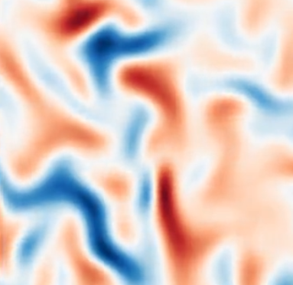
Magnetohydrodynamic Turbulence
Anindya Guria
Indian Institute of Science
April 2024

Slide 2
List of topics
Magnetohydrodynamics (MHD)
Turbulence
MHD Turbulence
Pseudospectral algorithm
Numerical setup & computation technique
Results & Analysis
An aside: volume penalization
Theory
Simulation

Slide 3
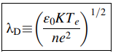
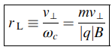
Magnetohydrodynamics (MHD)
MHD describes the macroscopic behavior of an electrically conducting fluid : usually plasma
Spatial scales need to be larger than intrinsic length scales of the plasma such as :
Debye length
Larmor radii
Mean free path << gradient scales

Slide 4
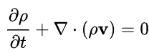
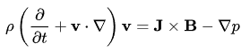
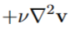
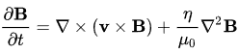
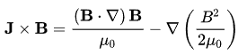
MHD Equations
Continuity Equation
Momentum equation
Induction equation
Ampere’s law
Lorentz Force

Slide 5
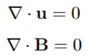
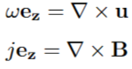
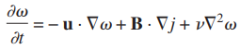
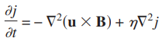
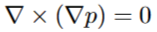
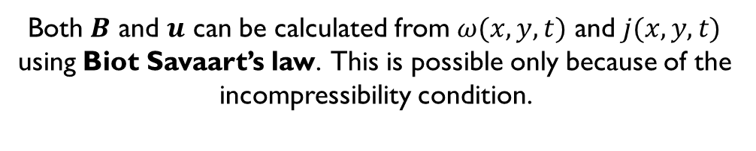
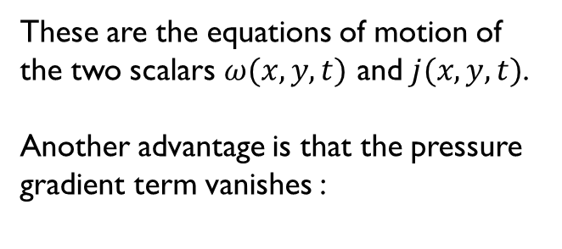
2-D Incompressible MHD
In 2-D it is convenient to work with the vorticity field, as it can be treated like a scalar.
These are the equations of motion of the two scalars $ω(x,y,t)$ and $j(x,y,t)$.
Another advantage is that the pressure gradient term vanishes :
Both $B$ and $u$ can be calculated from $ω(x,y,t)$ and $j(x,y,t)$ using Biot Savaart’s law. This is possible only because of the incompressibility condition.

Slide 6
Turbulence
Originates due to some instabilities in the system. Some examples are:
Rayleigh-Taylor instability (density gradient opposite to gravity; convection)
Kelvin-Helmholtz instability (sheared flow)
After the onset of instabilities, the flow structure gets very complex and irregular.
Minimal changes in the system leads to unpredictable future flow states.

Slide 7
Turbulent dissipation
The kinetic energy of the turbulent flow is dissipated into the fluid’s internal energy due to viscous shear stress.
Turbulence causes formation of eddies of several length scales. The initial kinetic energy in large-scale structures “cascades” into smaller scales via an inviscid/inertial mechanism. (Richardson’s mechanism)
Eventually, the structures are small enough that molecular diffusion becomes important & viscous dissipation of energy as heat finally takes place!
This is called the “Kolmogorov Length Scale”

Slide 8
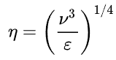
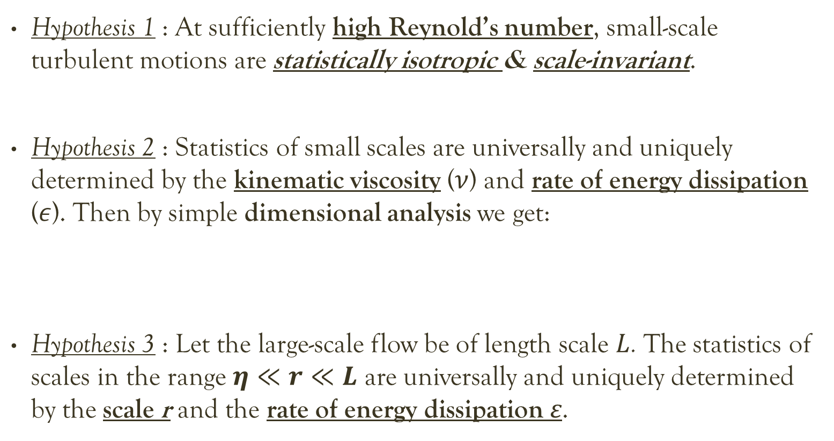
Kolmogorov’s 1941 theory
Hypothesis 1 : At sufficiently high Reynold’s number, small-scale turbulent motions are statistically isotropic & scale-invariant.
Hypothesis 2 : Statistics of small scales are universally and uniquely determined by the kinematic viscosity ($ν$) and rate of energy dissipation ($ε$). Then by simple dimensional analysis we get:
Hypothesis 3 : Let the large-scale flow be of length scale $L$. The statistics of scales in the range $η≪r≪L$ are universally and uniquely determined by the scale r and the rate of energy dissipation ε.
Kolmogorov Length Scale

Slide 9
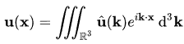
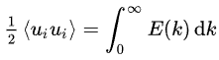
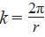
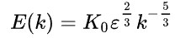
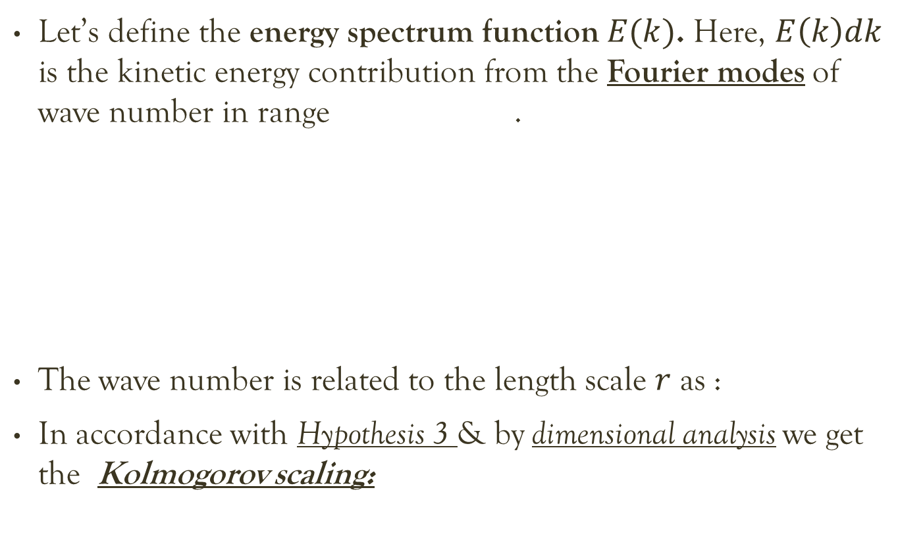
Kolmogorov’s 1941 theory
Let’s define the energy spectrum function $E(k)$. Here, $E\left(k\right)dk$ is the kinetic energy contribution from the Fourier modes of wave number in range .
The wave number is related to the length scale $r$ as :
In accordance with Hypothesis 3 & by dimensional analysis we get the Kolmogorov scaling:
Fourier transform of flow field
Mean turbulent kinetic energy

Slide 10
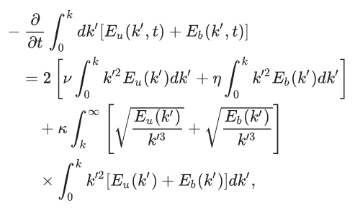
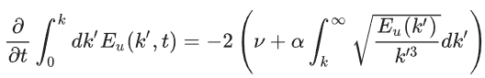
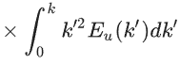
MHD Turbulence
Pioneering work done by S. Chandrasekhar. He derived an expression (1955b) for the evolution of spectral energy distribution:
This was based on the Heisenberg’s model for hydrodynamic turbulence:

Slide 11
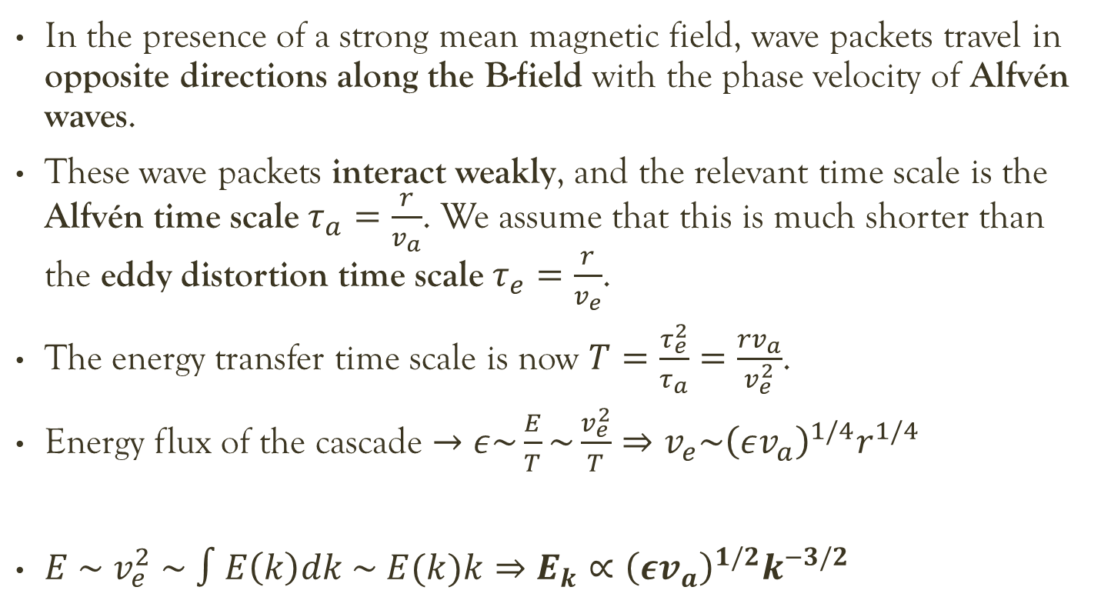
Iroshnikov-Kraichnan Model
In the presence of a strong mean magnetic field, wave packets travel in opposite directions along the B-field with the phase velocity of Alfvén waves.
These wave packets interact weakly, and the relevant time scale is the Alfvén time scale $τ_{a}=\frac{r}{v_{a}}$. We assume that this is much shorter than the eddy distortion time scale $τ_{e}=\frac{r}{v_{e}}$.
The energy transfer time scale is now $T=\frac{τ_{e}^{2}}{τ_{a}}=\frac{rv_{a}}{v_{e}^{2}}$.
Energy flux of the cascade $→ε\sim \frac{E}{T}\sim \frac{v_{e}^{2}}{T}⇒v_{e}\sim {\left(εv_{a}\right)}^{1/4}r^{1/4}$
$E \sim v_{e}^{2} \sim ∫E\left(k\right)dk \sim E(k)k⇒E_{k}∝{\left(εv_{a}\right)}^{1/2}k^{−3/2}$

Slide 12
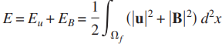
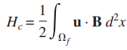
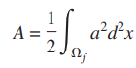
2-D MHD turbulence
Investigating turbulence by Direct Numerical Simulation (DNS) requires high spatial resolution to capture the multi-scale effect.
Artificial 2-D system higher resolution than 3-D with similar computational cost.
An important peculiarity : Unlike ordinary turbulence in 3-D, we have inverse cascade of Energy in 2-D turbulence!
Total energy
Cross helicity
Mean-squared vector potential
Invariant quantities in
ideal 2-D MHD

Slide 13
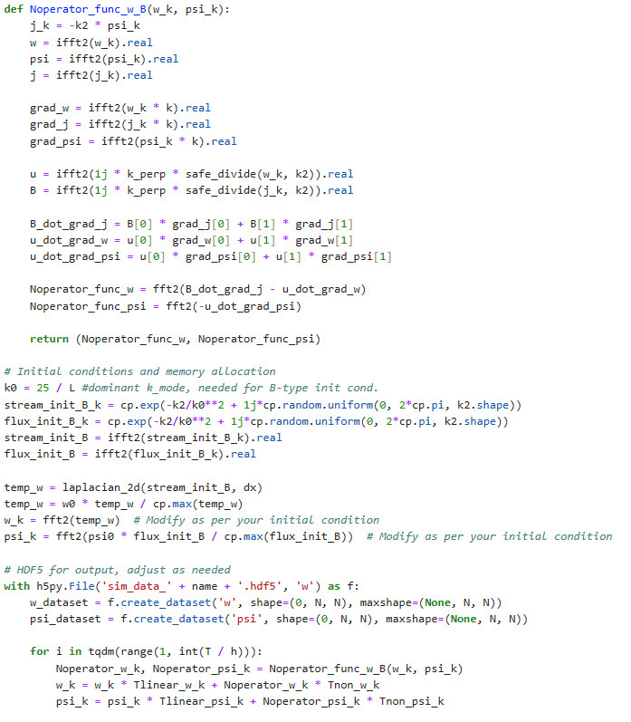
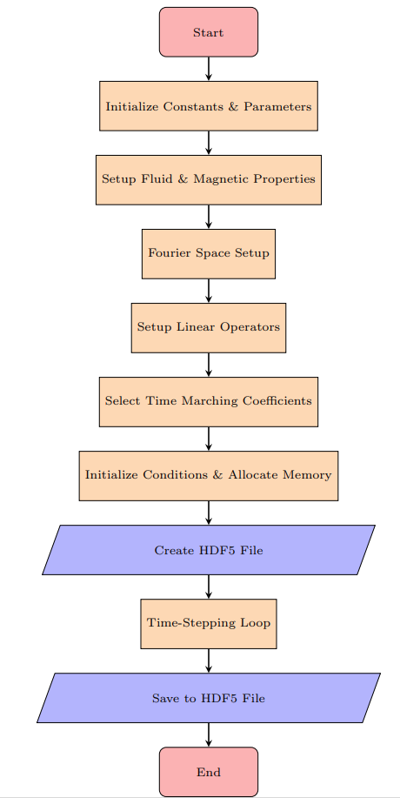
In the scope of this project, I wrote a GPU-enabled Python code to simulate MHD turbulence using Pseudospectral algorithm
I will discuss the numerical method and show some of the results I obtained!

Slide 14
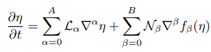
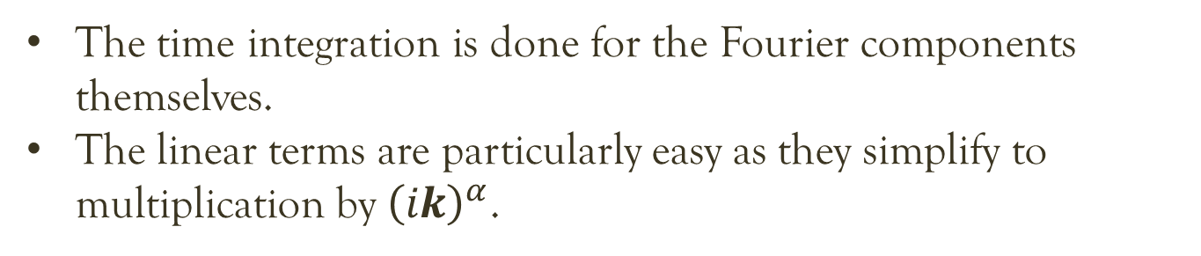
The Pseudo-spectral algorithm
It is method of solving coupled non-linear partial differential equations by Fourier transforming the spatial dependence into wave-vector space.
Linear operators
Non-linear operators
The time integration is done for the Fourier components themselves.
The linear terms are particularly easy as they simplify to multiplication by ${\left(ik\right)}^{α}$.

Slide 15
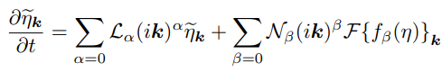
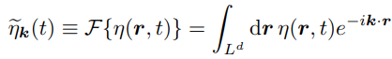
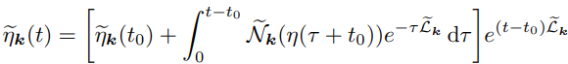
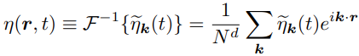
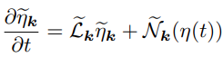
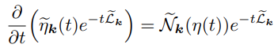
The Pseudo-spectral algorithm
To evaluate the non-linear terms, we need to inverse transform to the real space, compute them and forward transform back to the Fourier space.

Slide 16
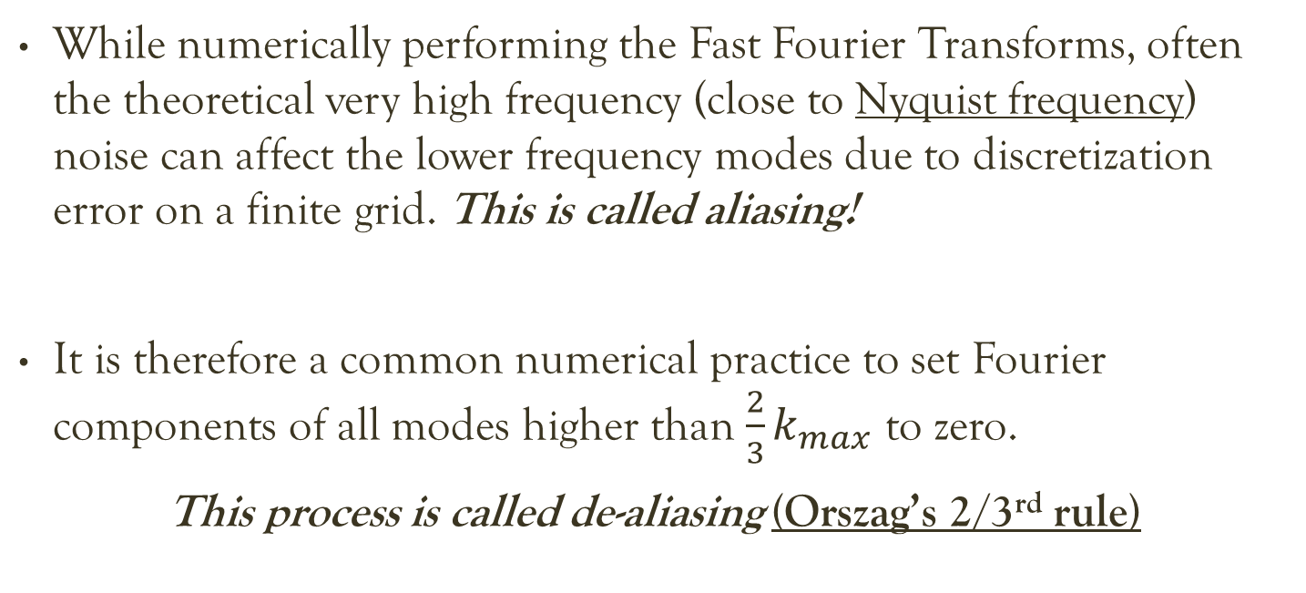
Dealiasing for stability
While numerically performing the Fast Fourier Transforms, often the theoretical very high frequency (close to Nyquist frequency) noise can affect the lower frequency modes due to discretization error on a finite grid. This is called aliasing!
It is therefore a common numerical practice to set Fourier components of all modes higher than $\frac{2}{3}k_{max}$ to zero.
This process is called de-aliasing (Orszag’s 2/3rd rule)

Slide 17
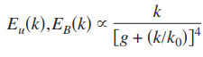
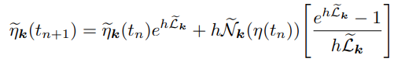
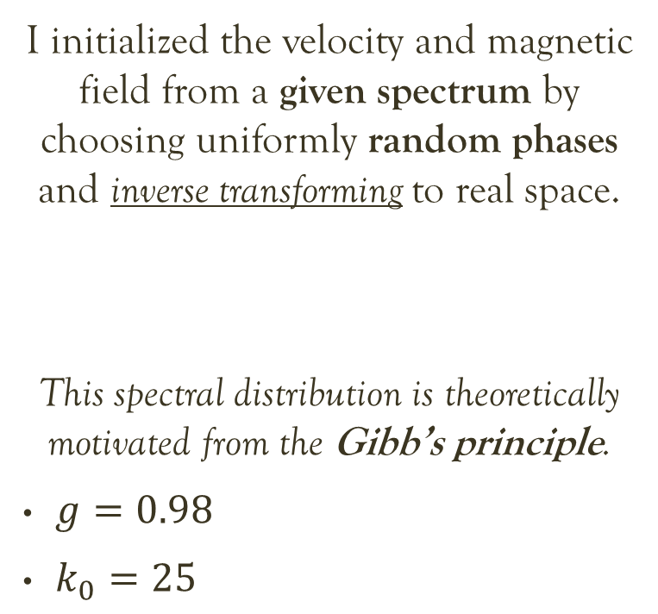
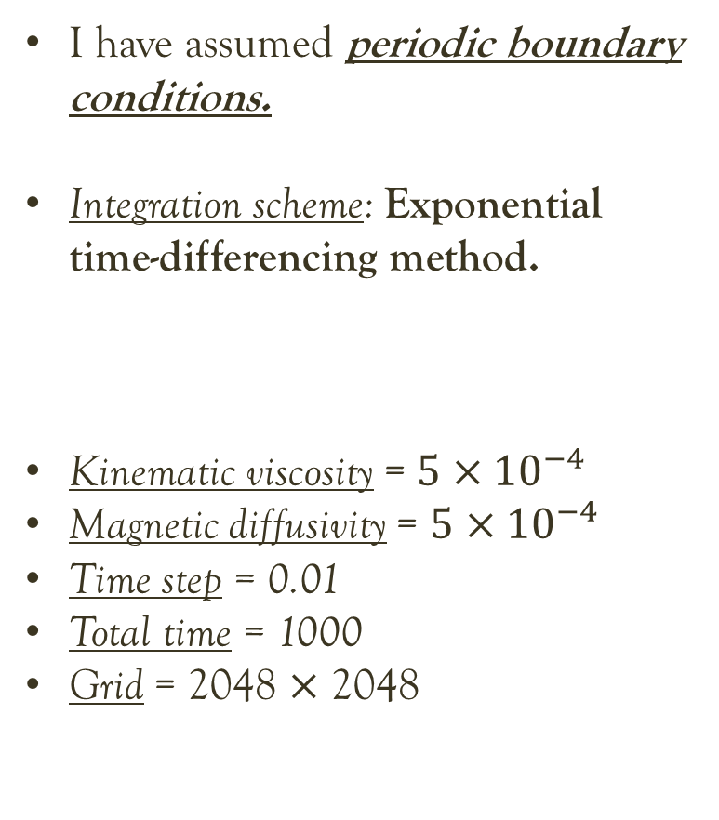
Simulation setup
I have assumed periodic boundary conditions.
Integration scheme: Exponential time-differencing method.
Kinematic viscosity = $5×{10}^{−4}$
Magnetic diffusivity = $5×{10}^{−4}$
Time step = 0.01
Total time = 1000
Grid = 2048 $×$ 2048
I initialized the velocity and magnetic field from a given spectrum by choosing uniformly random phases and inverse transforming to real space.
This spectral distribution is theoretically motivated from the Gibb’s principle.
$g=0.98$
$k_{0}=25$

Slide 18
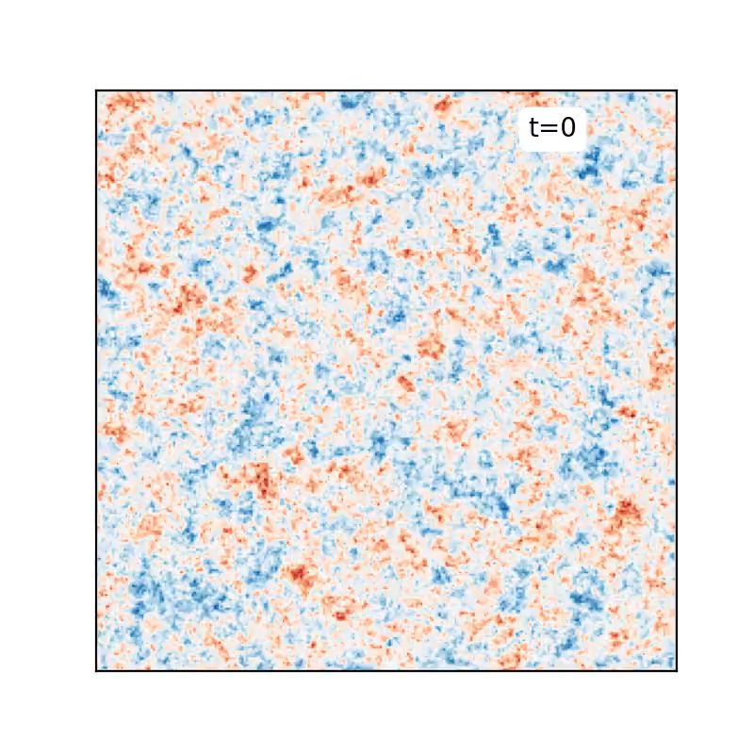
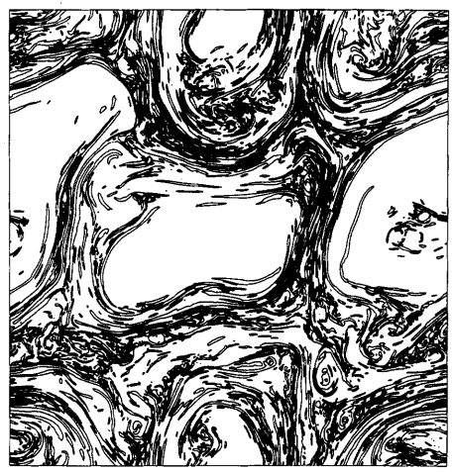
Results - I
Current density evolution with time
Notice how there is formation of flat current sheets
hhh
Biskamp et al. 1989
My simulation

Slide 19
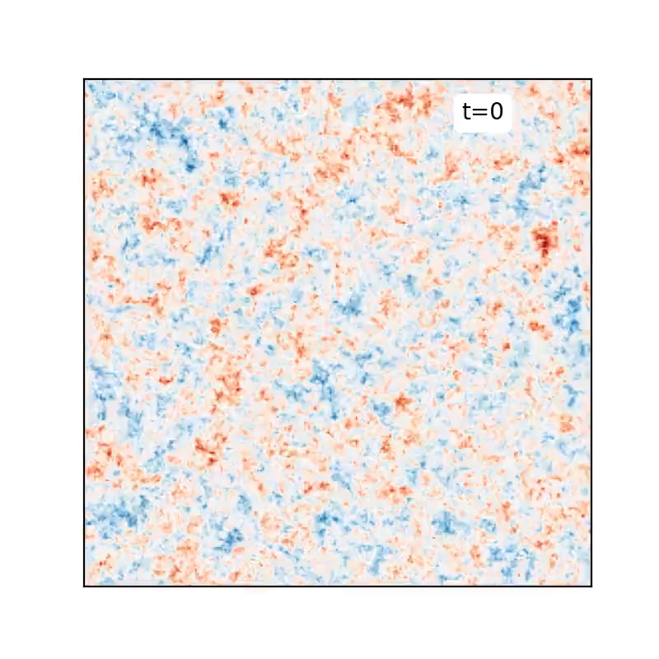
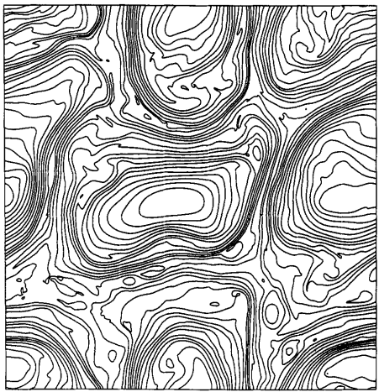
Results - II
Vorticity evolution with time
Notice how there is formation of large-scale structures of higher k-modes : inverse cascade
Biskamp et al. 1989
My simulation

Slide 20
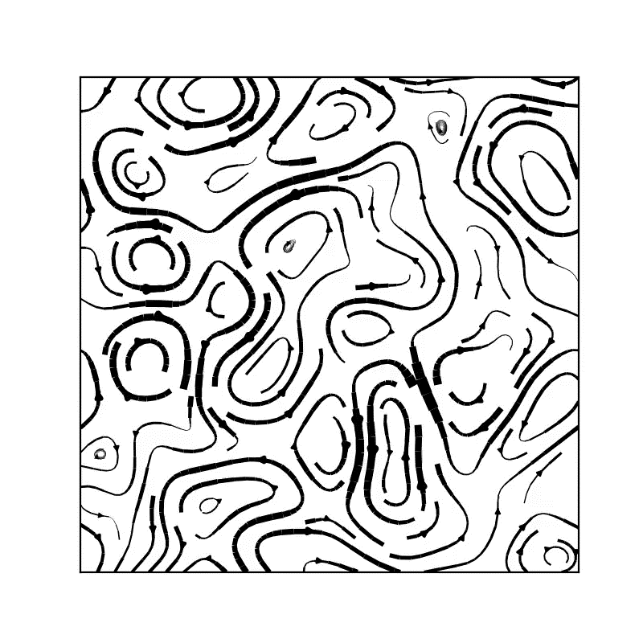
Results - III
Velocity evolution with time
Notice how there is formation of large-scale structures of higher k-modes : inverse cascade
Dissipation of kinetic energy due to viscosity and coupling to B-field is visible.
My simulation

Slide 21
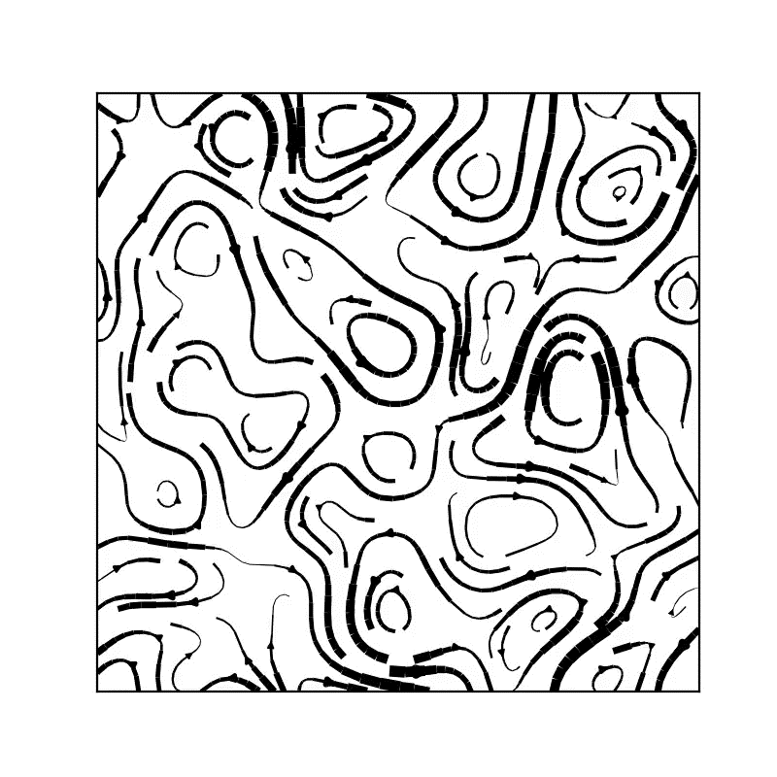
Results - III
Magnetic field evolution with time
Notice how there is formation of large-scale structures of higher k-modes : inverse cascade
My simulation

Slide 22



Results - IV
Energy spectra evolution with time
I found the scaling power law to range between$−0.50$ to $−1.05$.
This is neither close to Kolmogorov’s -5/3 or
Iroshnikov-Kraishnan’s -1.5.
Also, theoretically a steep cut-off at high $k$ is expected, which I didn’t find.
Energy ($E_{k}$)

Slide 23


Volume penalization
A major drawback of Pseudospectral method is the requirement of periodic boundary condition. Without this, it is theoretically not possible to work with a discrete set of k-modes! One would need a continuum of modes otherwise.
Volume penalization is a workaround to this problem; it is useful for extending the scope of spectral methods to finite domains applicable for real world.
To do this, we modify our equations by adding a masking term $χ\left(x,y\right):$

Slide 24





Volume penalization
In terms of vorticity and current density:
In the limit $ε→0$, the velocity and magnetic field in the region $Ω_{s}$ must be equal to their boundary values $u_{0}$ and $B_{0}$ which we are free to set or choose as needed.
$$χ\left(Ω_{f}\right)=1$$
$$χ\left(Ω_{s}\right)=0$$

Slide 25


Result – Cylindrical cavity
Vorticity evolution
Current density evolution
I initialized the $ω$ and $j$ field inside the cylinder just as before. I attempted to see driven turbulence by setting a constant surface current on the cylinder’s boundary.

Slide 26

Thank You
Best Regards,
Anindya Guria
20414

